Slide 1

OilSignal
What we do
Our approach
Results
Insights
01 / 21
GRADUATE PROJECT DEFENSE
Trump Tweets, Sentiment, and Crude Oil Prediction
Applied NLP, Machine Learning, Time-Series Features, and Power BI Analytics
1,903
228
0.5257
final daily modeling rows
engineered columns
best balanced accuracy
Analyzing the Impact of Trump’s Social Media Sentiment on Crude Oil Price Movements
Zaid Alraggad | Ahmad Junidi | Mahmood Sanwar | Academic Year 2025/2026

Slide 2

02 / 21
DEFENSE ROADMAP
Project flow: from business question to validated evidence
01
02
03
04
Problem & claim
Data & NLP
Validation & models
Results & defense
Define the research question and avoid exaggerated claims.
Prepare text, score sentiment, engineer keywords, and merge by date.
Use safe targets, leakage control, baselines, and fair model comparison.
Explain results, limitations, future work, and final conclusion.
Core stance: this project does not claim tweets control oil; it tests whether sentiment adds measurable signal.

Slide 3

03 / 21
RESEARCH FRAMING
Research question and analytical claim
Research Question
Analytical Claim
Can Trump social-media sentiment and market-related language improve prediction of next-day crude oil direction?
Tweets are treated as a possible weak signal. The result is only useful if it is tested against oil-only and dummy baselines.
Hypothesis
Meaning
H1
Sentiment may contain a limited directional signal.
H2
Sentiment must add value beyond oil-history features.
H3
Weak performance means limited market signal, not necessarily project failure.

Slide 4
OilSignal
What we do
Our approach
Results
Insights
04 / 21
PROBLEM CONTEXT
Why oil prediction is difficult
• Oil prices respond to many forces: OPEC, inventories, sanctions, wars, inflation, interest rates, FX, and expectations. • Tweets are noisy and often political rather than directly energy-related. • Daily data can miss fast reactions that happen within hours. • Random splits or same-day targets can create fake accuracy.
Bad claim
“Trump tweets predict oil prices.”
Defensible claim
“Tweet sentiment may add a limited signal, but only after strict validation.”

Slide 5
Defense
05 / 21
OBJECTIVES & SCOPE
Objectives, scope, and boundaries
Included
Not claimed
• Prepare Trump posts and crude oil price data. • Clean text and score sentiment. • Build keyword, engagement, lag, and rolling features. • Create next-day targets without future leakage. • Compare dummy, oil-only, and sentiment-enhanced models. • Present results through Power BI dashboards and honest interpretation.
2017–2025 posts
Causal proof
Daily oil + optional hourly context
Trading system
NLP + ML + dashboards
Guaranteed high accuracy
Event study + error analysis
Complete macro coverage

Slide 6
OilSignal
What we do
Our approach
Results
Insights
06 / 21
METHODOLOGY
Methodology
The notebook turns raw tweets and oil prices into a validated analytics workflow.
From raw data to defensible evidence
clean → score sentiment → engineer features → split chronologically → model → dashboard → conclude

Slide 7
OilSignal
What we do
Our approach
Results
Insights
07 / 21
DATA SOURCES
Data sources and dataset size
Dataset
Rows
Columns
Purpose
Trump tweets raw
58,392
18
Raw social-media text
58,392
2,252
Cleaned tweets
58,389
33
NLP-ready records
raw tweet rows
daily oil rows
Daily crude oil
2,252
07 / 21
Market features
Hourly oil raw
89,395
7
Intraday context
1,903
228
Final merged table
1,903
228
Daily modeling table
merged daily rows
engineered columns

Slide 8
What we do
Our approach
Results
Insights
08 / 21
NOTEBOOK STRUCTURE
End-to-end code architecture
Stage
Code logic
Output
Setup & Loading
Libraries, paths, CSV loading
Raw dataframes
Cleaning & NLP
Text cleaning, VADER/TextBlob
Sentiment scores
Feature Engineering
Keywords, aggregation, oil lags
Daily model table
Validation
Leakage audit + chronological split
Train/test data
Modeling & Diagnostics
Models, event study, errors
Metrics & visuals
Defense logic: every code block reduces noise, avoids leakage, tests the signal, compares baselines, or explains results.

Slide 9
OilSignal
What we do
Our approach
Results
Insights
09 / 21
CODE 1 — SETUP & VALIDATION
Reproducible loading before modeling
import os, re, warnings from pathlib import Path import numpy as np import pandas as pd warnings.filterwarnings('ignore') RANDOM_STATE = 42 TEST_SIZE = 0.20 TWEETS_PATH = find_existing_path(TWEETS_PATH_CANDIDATES) OIL_DAILY_PATH = find_existing_path(OIL_DAILY_PATH_CANDIDATES) df_raw = pd.read_csv(TWEETS_PATH) oil_daily_raw = pd.read_csv(OIL_DAILY_PATH) required_tweet_cols = ['date', 'text'] missing = [c for c in required_tweet_cols if c not in df_raw.columns] if missing: raise ValueError(f'Missing columns: {missing}')
• Uses RANDOM_STATE = 42 for reproducibility.
• Works in Colab, local folders, and /mnt/data.
• Validates required columns early.
• Professional projects fail early with clear errors.

Slide 10
OilSignal
What we do
Our approach
Results
Insights
10 / 21
DATA PREPARATION PIPELINE
DATA CLEANING & NL+PSENTIMENT LOGIC+FEATURE ENGINEERING+MERGE + LEAKAGE CONTROL
1. DATA CLEANING & NLP
2. SENTIMENT LOGIC
clean_text = clean_text_for_sentiment(text)
# remove URLs, mentions, media links
polarity = VADER compound score
subjectivity = TextBlob fallback
• Creates clean_text before NLP.
• Reduces platform noise before sentiment.
• Keeps useful hashtag words for keywords.
• Turns tweet text into numeric signals.
• VADER fits short social-media text.
• Sentiment is an input, not a conclusion.
3. FEATURE ENGINEERING
4. OIL TARGET DESIGN
daily_tweets = df.groupby(date_day).agg(...)
market_keyword_mentions = sum(counts)
return_pct = close.pct_change() * 100
target = return_pct.shift(-1)
• Builds one analytical record per day.
• Captures oil, OPEC, trade, sanctions, inflation.
• Adds tweet count, sentiment, and engagement.
• Predicts next-day oil direction/return.
• Uses lags and rolling features.
• Avoids same-day leakage before modeling.
clean_text → sentiment_score → daily_tweets features → oil lags/rolling features → next-day target

Slide 11
What we do
Our approach
Results
Insights
11 / 21
MERGE + LEAKAGE CONTROL
Time-aware table and chronological split
daily_merged = pd.merge( daily_tweets, oil_model_daily, on='day', how='inner' ).sort_values('day') for lag in [1, 2, 3, 5, 7, 14]: for col in tweet_lag_base_cols: daily_merged[f'{col}_lag{lag}'] = daily_merged[col].shift(lag) for window in [3, 7, 14]: for col in rolling_base_cols: daily_merged[f'{col}_roll_mean_{window}'] = ( daily_merged[col].shift(1).rolling(window).mean() ) train_df, test_df = chronological_train_test_split(daily_merged)
Subset
Rows
Period
Training
1,522
2017-02-09 to 2024-06-24
Testing
381
2024-06-25 to 2025-12-30
Defense line
shift(1) before rolling means the model only sees previous information.

Slide 12
OilSignal
What we do
Our approach
Results
Insights
12 / 21
FEATURE SETS
Baseline vs sentiment-enhanced features
Oil-only baseline
Sentiment-enhanced model
• Oil return lags
• Oil close lags
• Oil volume lags
• Volatility and rolling features
• Baseline oil features
• Average sentiment
• Tweet count and engagement
• Keyword mentions and lags
Fair test: the project asks whether tweet features add value beyond oil-history features, not whether a model can memorize the dataset.
Source: Uploaded notebook: feature set and scaling cells.

Slide 13
13 / 21
MODELING
Model development and evaluation metrics
Task
Models
Metrics
Regression
Dummy, Ridge, Huber, RF, GB
MAE, RMSE, R²
Classification
Dummy, Logistic, RF, GB
Accuracy, Balanced Accuracy, F1, ROC AUC
Interpretation
Oil-only vs sentiment-enhanced
Do not hide weak results
Dummy
Oil-only
Sentiment
Balanced accuracy
no-skill benchmark
market history only
tweet-added signal
fairer under imbalance

Slide 14
OilSignal
What we do
Our approach
Results
Insights
14 / 21
CODE 7 — MODELS
Model dictionaries for fair comparison
regression_models = { 'Dummy Mean': ('baseline', DummyRegressor(strategy='mean')), 'Oil Baseline RF': ('baseline', RandomForestRegressor( n_estimators=250, max_depth=5, random_state=RANDOM_STATE)), 'Sentiment RF': ('sentiment', RandomForestRegressor( n_estimators=250, max_depth=5, random_state=RANDOM_STATE)), 'Sentiment GB': ('sentiment', GradientBoostingRegressor( n_estimators=150, max_depth=2, learning_rate=0.05, random_state=RANDOM_STATE)) } classification_models = { 'Dummy Majority': ('baseline', DummyClassifier(strategy='most_frequent')), 'Oil Baseline RF': ('baseline', RandomForestClassifier( n_estimators=250, max_depth=5, class_weight='balanced')), 'Sentiment RF': ('sentiment', RandomForestClassifier( n_estimators=250, max_depth=5, class_weight='balanced')) }
• Dummy models define the minimum benchmark. • Oil-only models test price-history information. • Sentiment models test the added value of tweets. • RF and GB capture nonlinear relationships. • Balanced class weights reduce bias from class imbalance.

Slide 15
OilSignal
What we do
Our approach
Results
Insights
15 / 21
MODEL RESULTS
Regression and classification results
-0.0205
2.0340
0.5197
0.5257
best R²: Dummy Mean
MAE for Dummy Mean
Sentiment RF accuracy
balanced accuracy
Key conclusion: sentiment added a small directional signal, but it did not strongly explain the size of next-day oil returns.
The gain over oil-only RF balanced accuracy was about +0.0120: useful academically, but too small to overclaim.

Slide 16
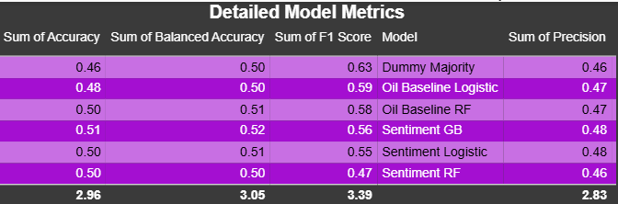
OilSignal
What we do
Our approach
Results
Insights
16 / 21
ERROR REALITY
Confusion matrix and error reality
Event study and model comparison
Pred Down/Flat
Pred Up
Actual Down/Flat
90
114
Actual Up
69
108
90
108
correct down/flat
correct up
114
69
false up
false down/flat
The confusion matrix proves the model is not strong enough for trading, but it is strong enough to support a weak-signal academic conclusion.

Slide 17
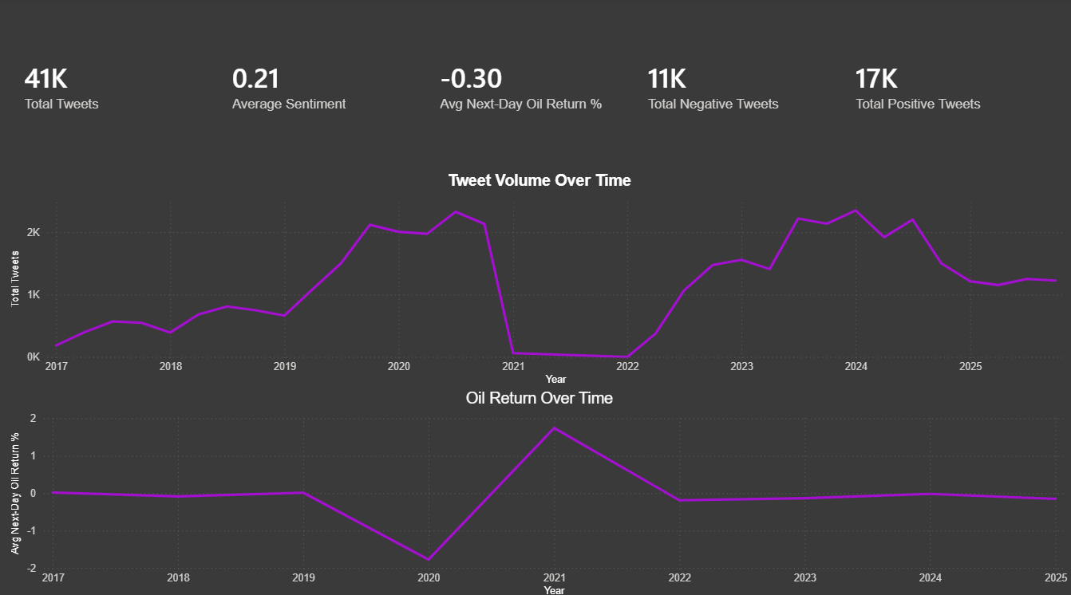
OilSignal
What we do
Our approach
Results
Insights
17 / 21
POWER BI DASHBOARD
Dashboard 1 — Tweet volume and oil return overview
Purpose
• Summarizes tweet count, average sentiment, positive/negative tweets, and next-day oil return. • Helps explain the dataset before model results. • This dashboard gives context; it does not prove prediction by itself.

Slide 18
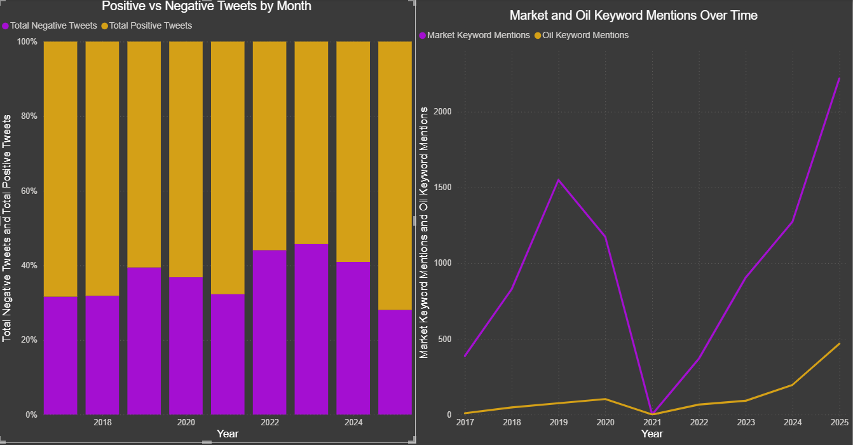
What we do
Our approach
Results
Insights
18 / 21
POWER BI DASHBOARD
Dashboard 2 — Sentiment distribution and keywords
Key insight
• Positive and negative sentiment are compared across time. • Market keywords appear more often than direct oil keywords. • This justifies keyword engineering instead of relying on raw sentiment only.

Slide 19
23 / 25
GDPR ETHICAL STANDARDS
How GDPR applies to our Trump tweets and crude oil analysis
1. Lawfulness, Fairness & Transparency
2. Data Minimisation & Purpose Limitation
Use public posts only for academic analysis and explain sentiment as a weak signal, not a personal judgment or causal claim.
Keep only project-needed fields such as date, cleaned text, sentiment, keywords, and engagement; use them only to test oil-price signal.
3. Integrity, Confidentiality & Accountability
Store project files, code, and dashboards securely; document the methodology clearly
and report results honestly without exaggerated causal claims.

Slide 20
20 / 21
LIMITATIONS + FUTURE
What the project cannot prove — and how to improve it
Limitations
Future Work
• No causal proof between tweets and oil movement. • Missing macro drivers: OPEC, EIA inventories, rates, FX, inflation, geopolitical shocks. • General sentiment tools may misread sarcasm or political tone.
• Add OPEC, EIA, inflation, rates, FX, and geopolitical datasets. • Use exact tweet timestamps with hourly oil prices. • Try financial NLP models such as FinBERT. • Connect oil movement to supply-chain indicators like fuel cost and shipping prices.

Slide 21
OilSignal
What we do
Our approach
Results
Insights
21 / 21
CONCLUSION
Final project conclusion
This project built a complete BI/DA workflow: text cleaning, sentiment scoring, feature engineering, leakage-safe validation, machine learning, dashboards, and interpretation.
The main result is honest and defensible: Trump tweet sentiment contains only a limited directional signal for crude oil movement.
Final statement: the project is valuable because it avoids overclaiming and clearly shows what the data can and cannot support.

